Slide 1
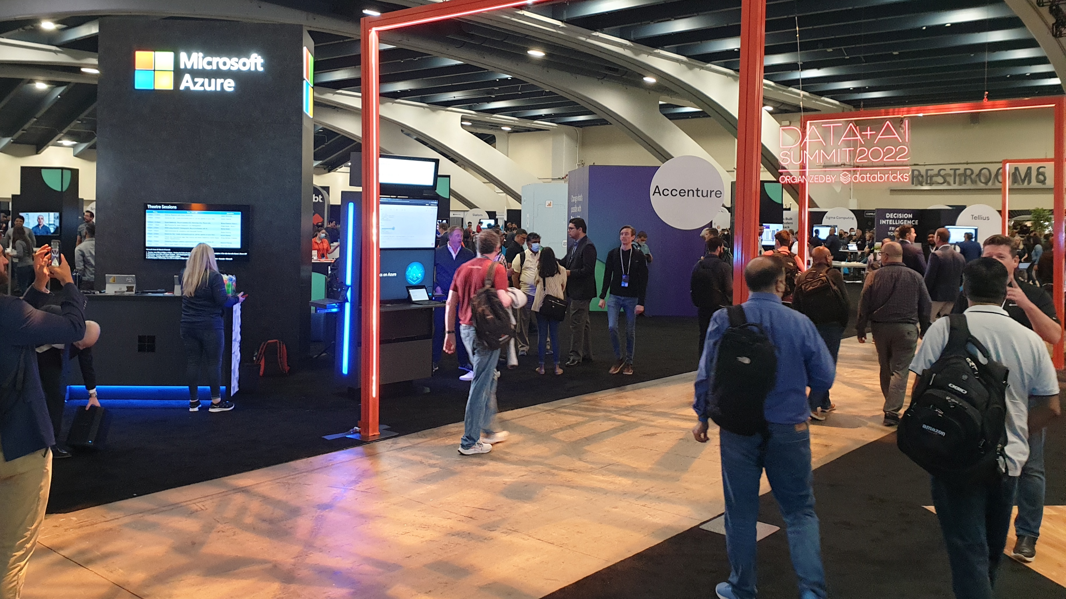
Learnings from Data+AI Summit 2022
A compilation of images & notes taken by Triet Pham

Slide 2
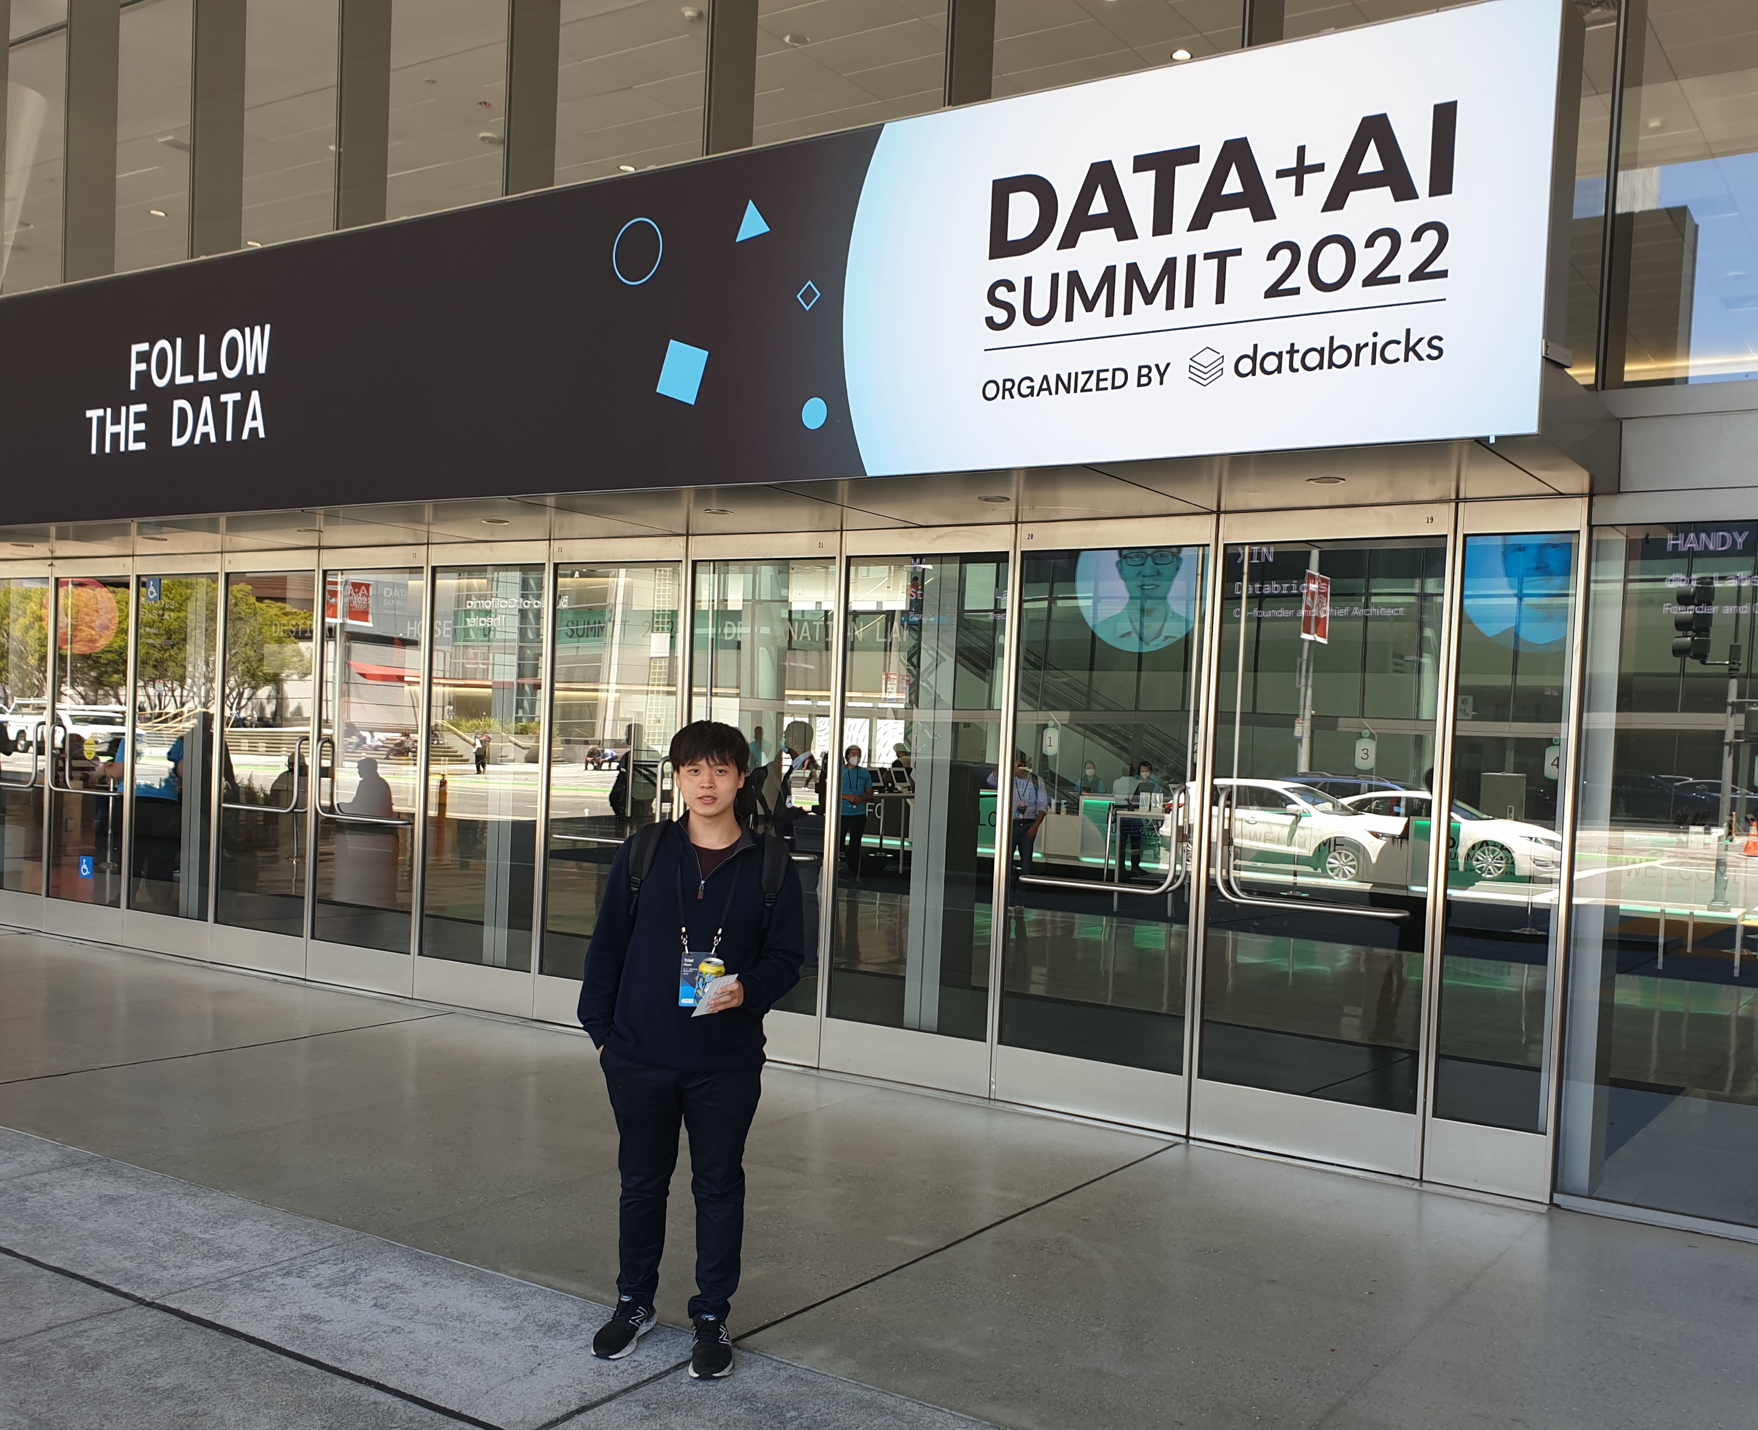
240+ technical sessions
50,000+ attendees (in-person & virtual) from 160+ countries
Spotted about 20 other attendees from Optum
40+ booths/vendors (from my counting)

Slide 3
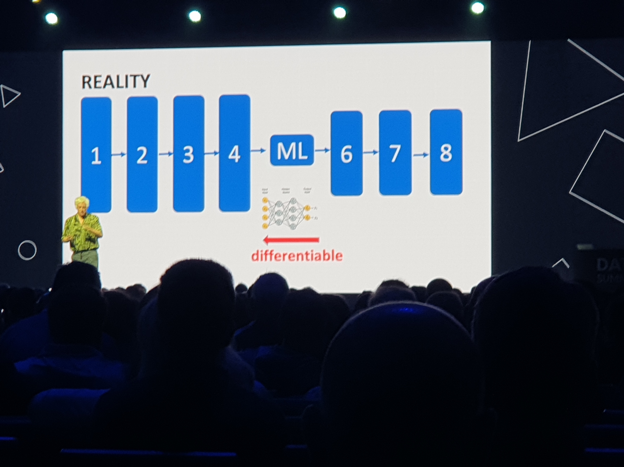
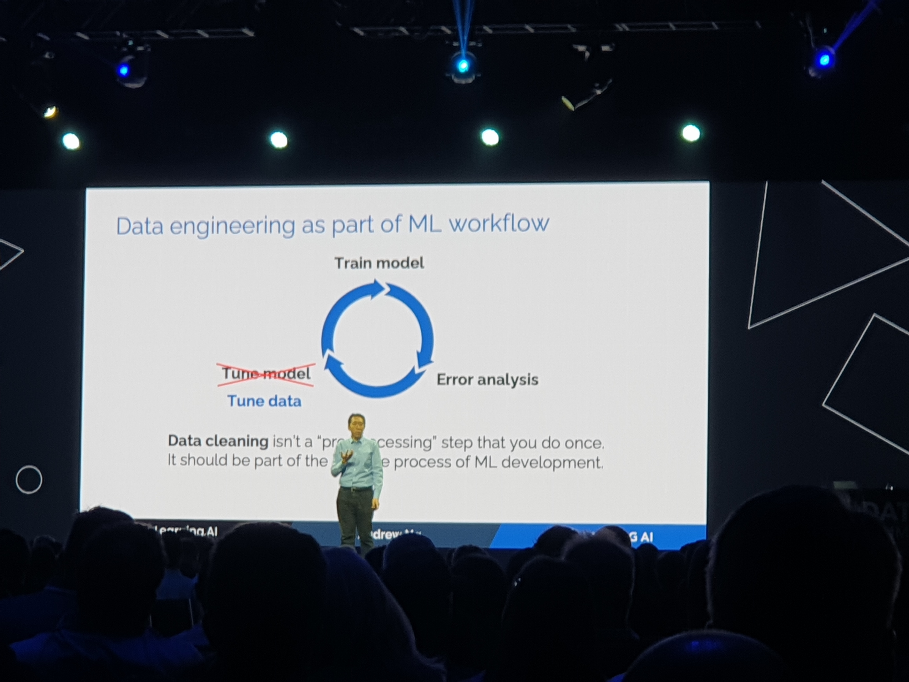
Theme 1: Data Centric vs Model Centric
A focus on improving data quality & data process over improving model quality.

Slide 4
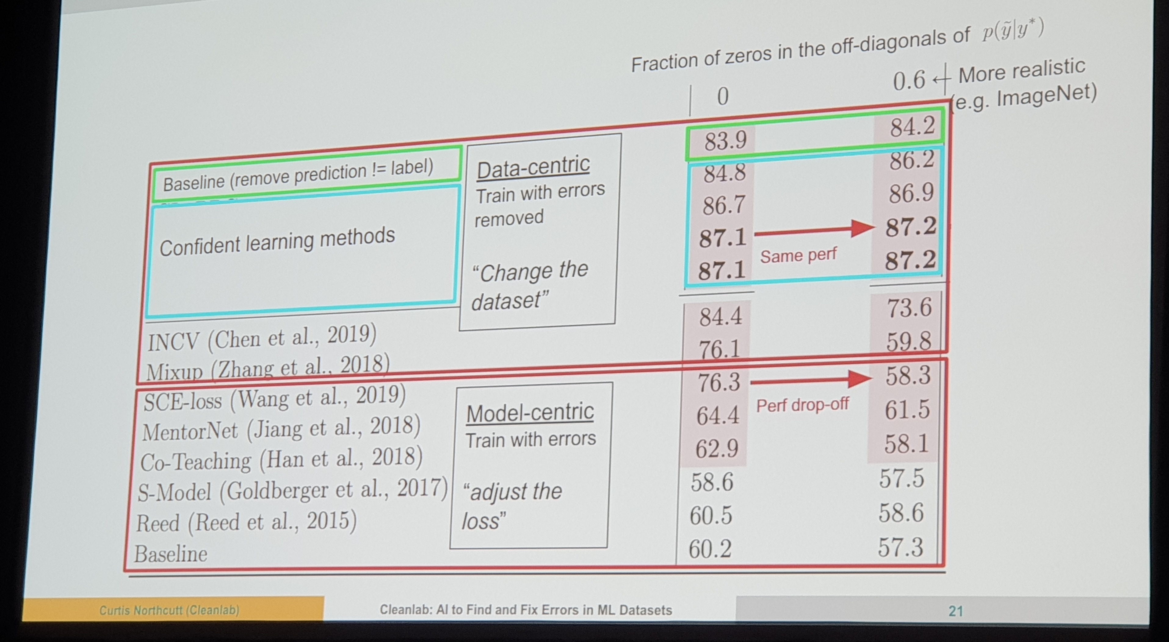
Theme 1: Data Centric vs Model Centric
Metrics from a paper comparing Confidence Learning performance on data-centric vs model-centric approach.
Shows that improving the dataset gives better performance than trying to improve the model.

Slide 5
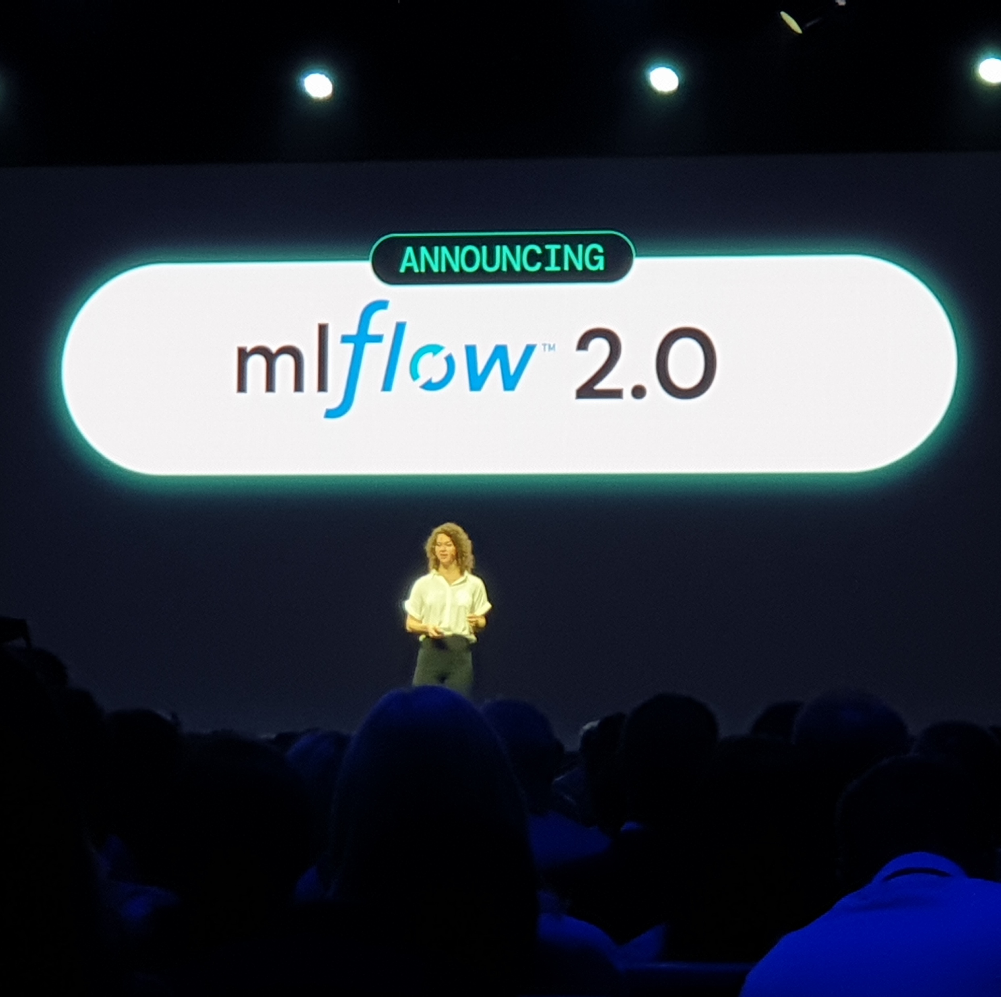
MLFlow 2.0 Announced
Introduces MLFlow Pipelines:
Encourages component-based development.
Allows notebook+IDE for both analytical and production development.
Introduce step cards where you can see different output information about different steps that are ran.
General improvements to things that MLFLow is known for (i.e. tracking model/experiments, and serving models)
New features like autologging, to keep codebase clean.
Notes:
https://mlflow.org/docs/latest/tracking.html#automatic-logging
https://docs.databricks.com/applications/mlflow/access-hosted-tracking-server.html

Slide 6
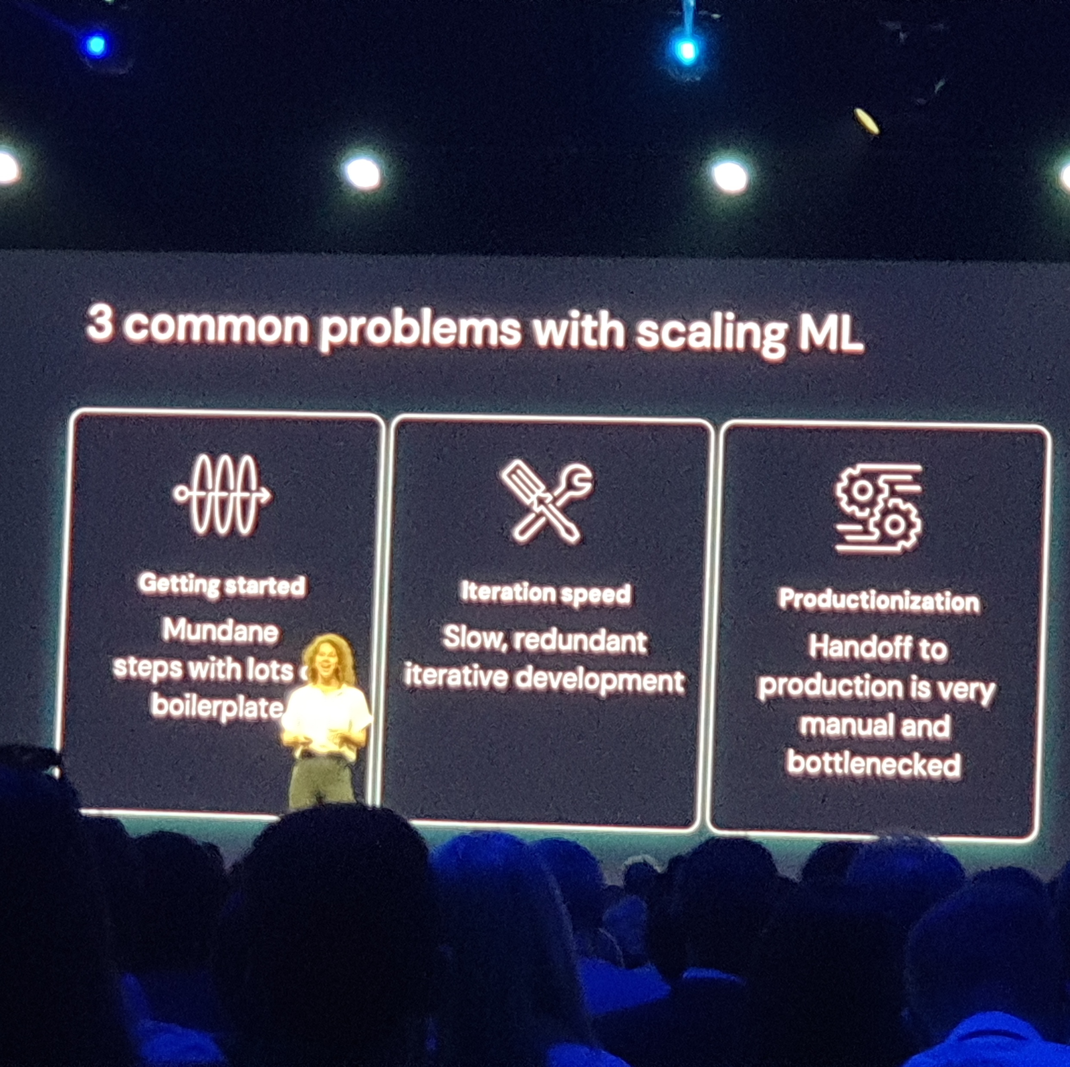
MLFlow Pipelines is for ModelOps
Pipeline templates: “get started faster”
pre-defined pipelines, production-ready templates
Pipeline engine: “accelerated development”
Caching of data/assets/config so that you only rerun steps that need to be rerun for an experiment. Steps are only re-run if it is a dependency for something else to run.
Opinionated structure: “automate handoffs”
Repo integration for handoffs. Much like github, allows you to do pull request on pipeline codes.
Logging of libraries dependencies, making reproducibility of the pipeline easy.
Notes:
MLFlow Pipeline Resources:
https://www.mlflow.org/docs/latest/pipelines.html
https://github.com/mlflow/mlp-regression-template

Slide 7
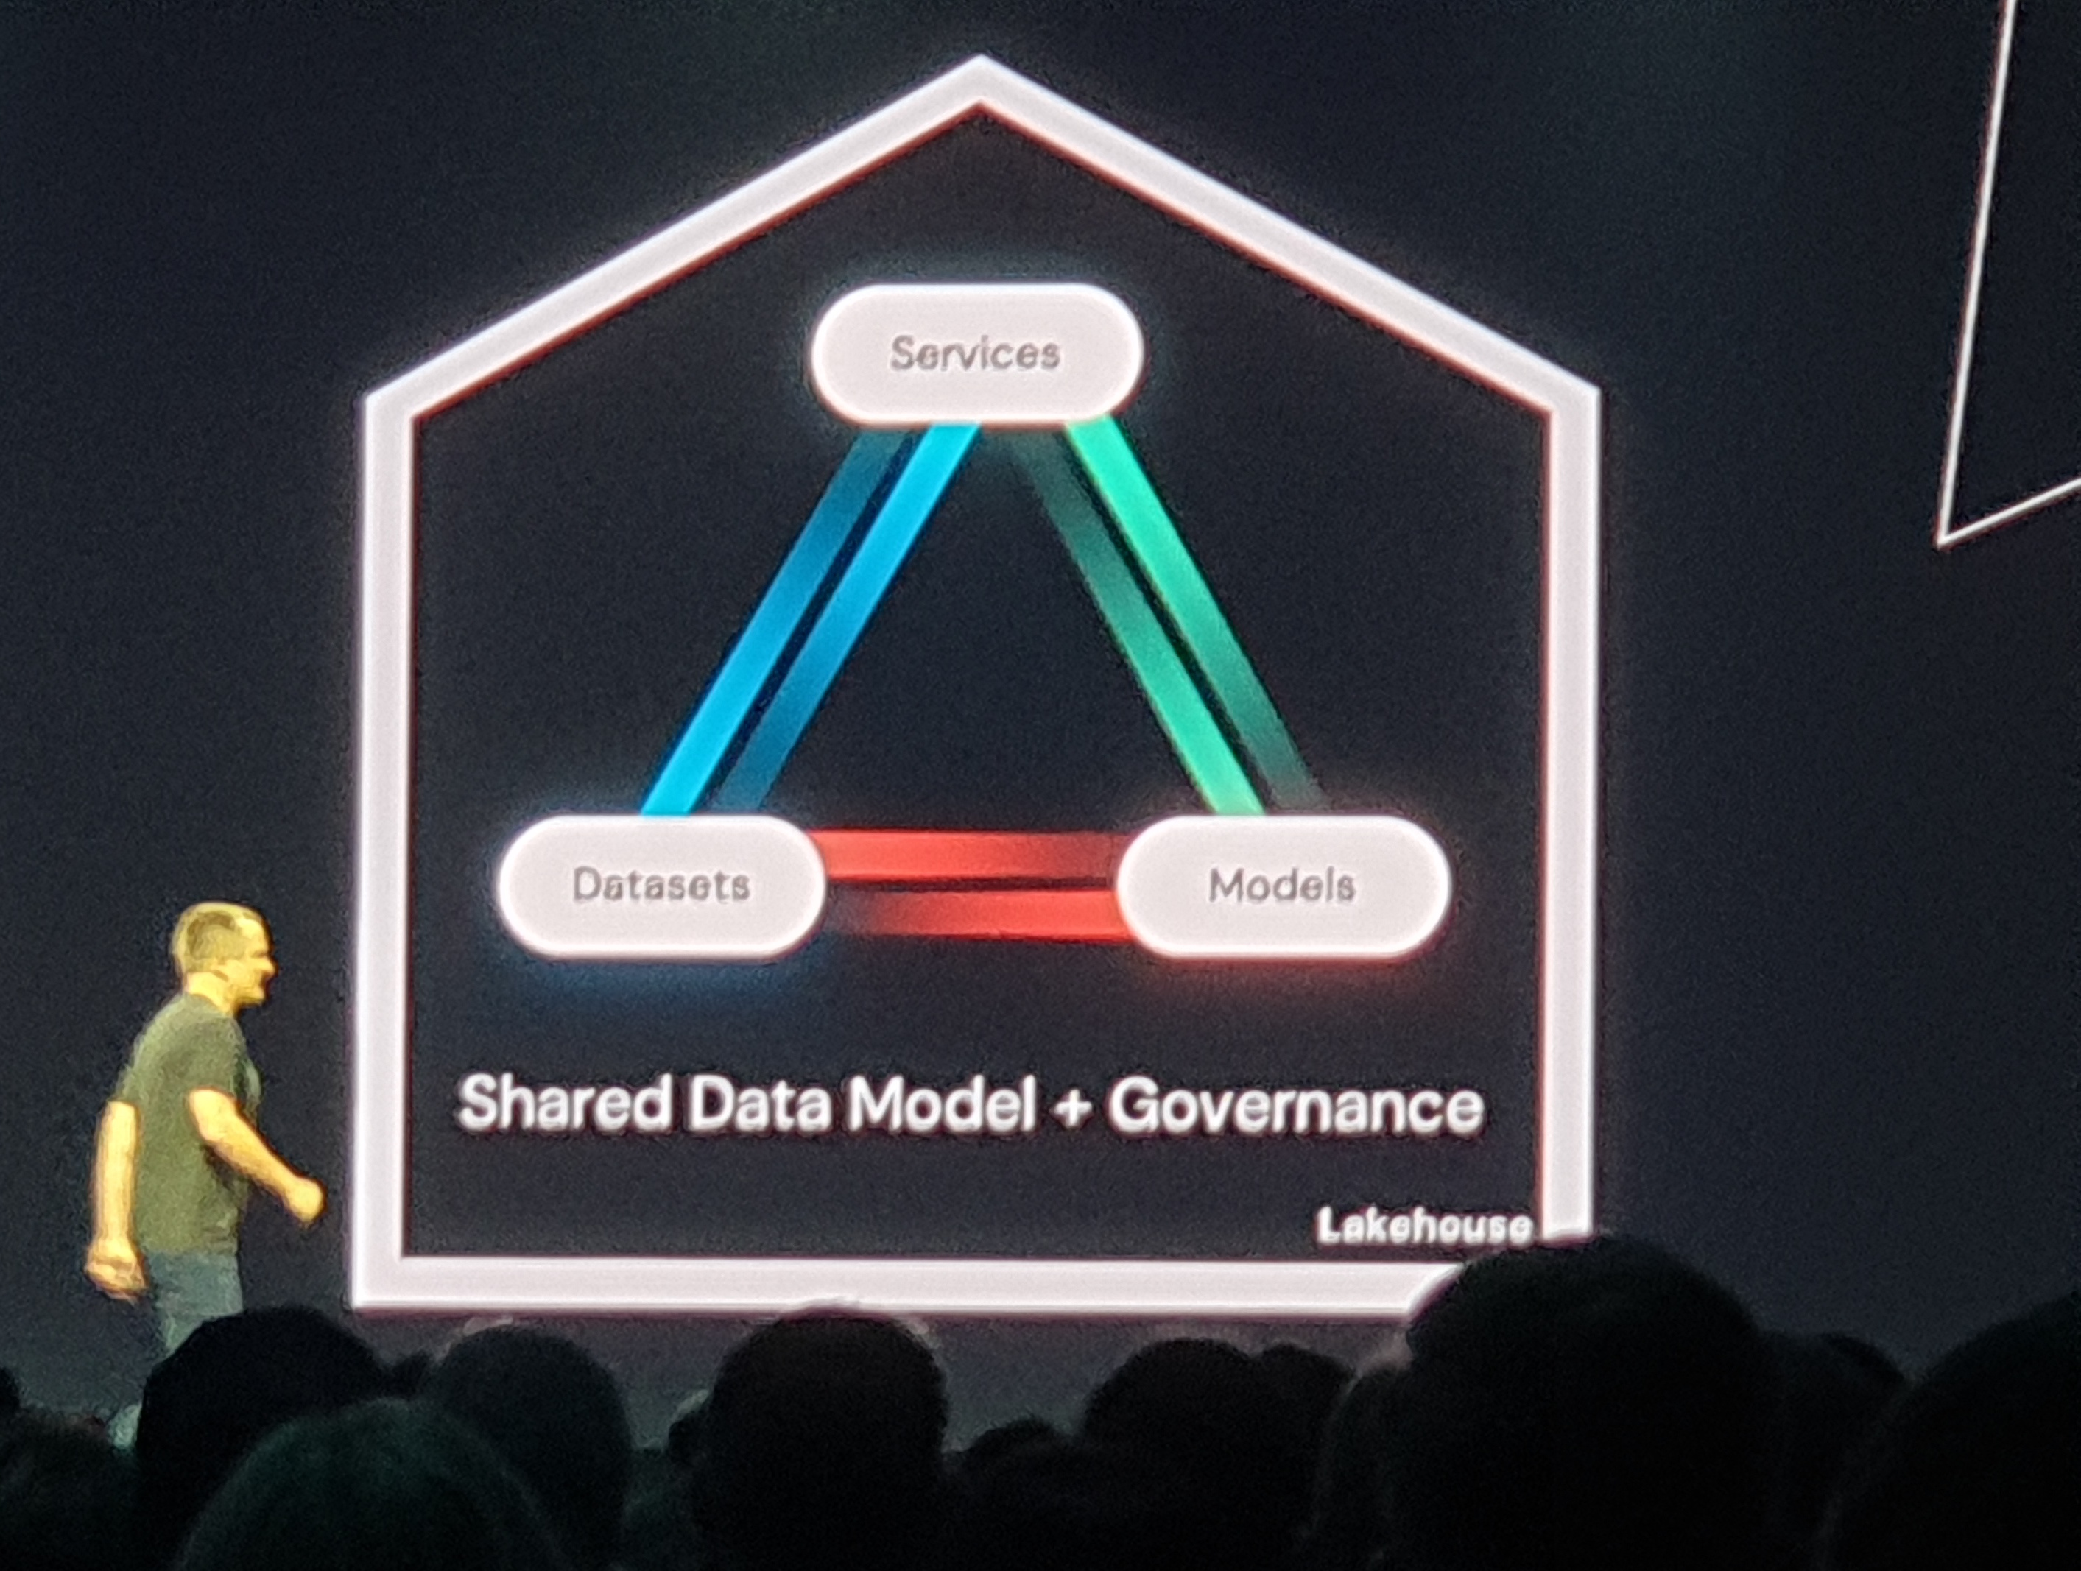
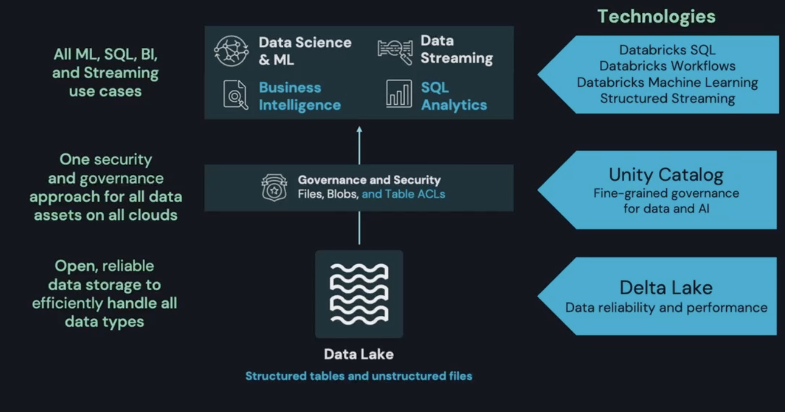
Theme 2: Data Lakehouse Paradigm
Lakehouse is an open architecture, which aims to unify data management & development in one location.
Notes:
Lakehouse is delivered as a service on AWS, Azure, Google cloud
Ingest data into delta lake tutorial: https://www.youtube.com/watch?v=iFLEc8cJYZ4

Slide 8
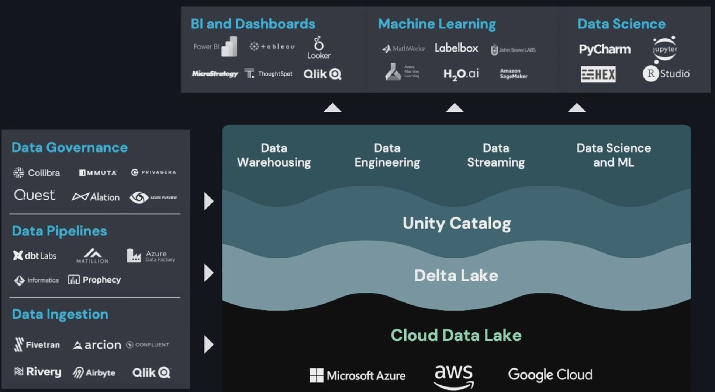
Theme 2: Data Lakehouse Paradigm
Open-sourced standards allow easy integration with other tools.

Slide 9
Data Lineage on Data Lakehouse
What is Data Lineage: Process of understanding, recording, and visualizing data as it flows from data sources to consumption.
Why Lineage is important: Compliance, Discovery, Data observability
Lineage service analyzed lineage events emitted from the cluster/SQL endpoint
Entities also have lineage i.e. notebook/workflow/dashboard
Collecting lineage patterns:
Manual linked by user
Inferred from SQL parsing
Auto capture during runtime
Lineage is part of the Unity catalog offering

Slide 10
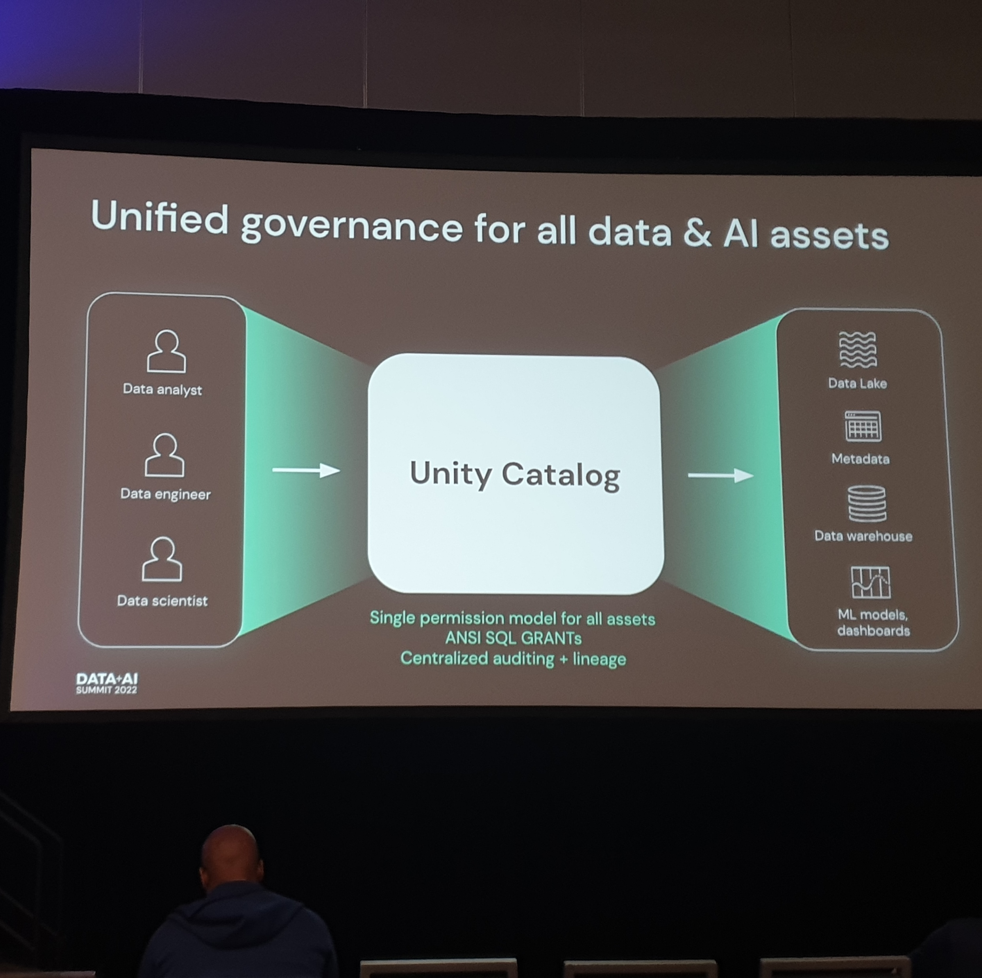
Unity Catalog
Governance & access control on Lakehouse.
Has a data explorer.
Unity Catalog permission model also manages who can view table/entity lineage.

Slide 11
Delta Live Tables
ETL Framework used for data pipelining.
Auto-compaction: optimizes file size to improve i/o.
Highly optimized reading parquet files.
Data versioning enables rollbacks, full historical audit trails, and reproducible machine learning experiments.
Incrementalization: updates derive datasets without recomputing everything
Enzyme: ETL automatic optimizer. Looks at the changes to the input and the query to pick the fastest technique to modify downstream tables.

Slide 12
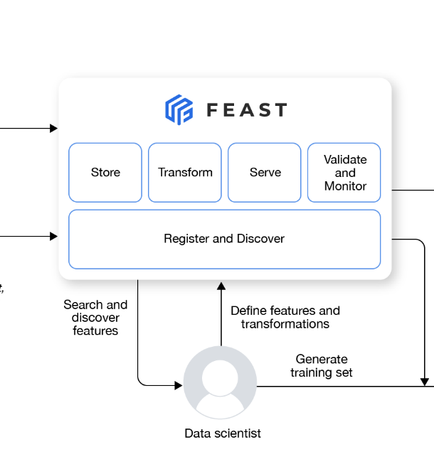
FEAture STore (Feast)
Component to manage e2e lifecycle of a feature, including transformations and serving
Encourages feature sharing and re-use
Data type conversions are expensive. Optimizes conversions to help production latency.
Feast is open-source pluggable.
Compatibility with Databricks:
Feast can be stored as delta tables
Deployed MLflow models can automatically retrieve features from Feature Store
Feature lineage trackable—data sources used to compute features and the models, notebooks, and jobs that use a specific feature.

Slide 13
What can we focus on at Optum
Embrace standardized MLOps from the start of projects.
Models built deployment ready, not solely sitting in a jupyter notebook on github.
Models that can respond to rapid changes in business & data from the real world.
Models that are reproducible and trackable.
Notes:
Getting started with MLOps at Optum resources:
https://iqsworkbench.optum.com/user-guide/
https://atc-playbook.optum.com/engineering/ml/mlops/

Slide 14
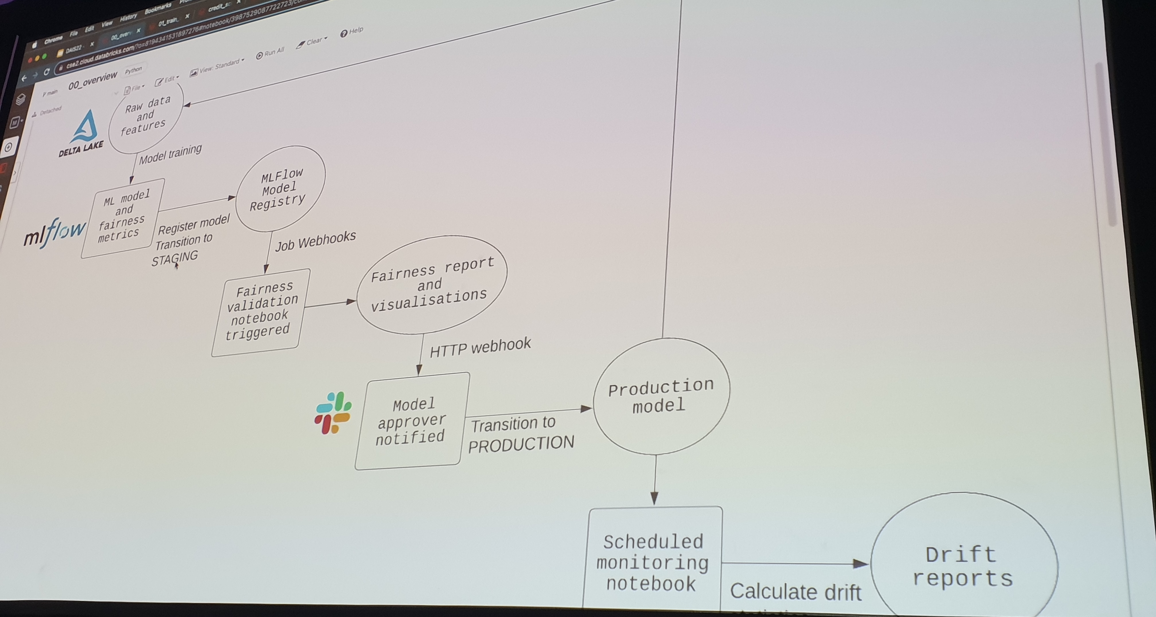
A look at MLOps for Fairness Testing

Slide 15
Other Sessions I Attended
Delta Lake Deepdive
Unity Catalog Deepdive
MLFlow Pipelines Deepdive
Scaling Deep Learning on Databricks
Productionizing Fair model with Delta Lake, Feature Store, MLFlow
Apache Spark + Tensorflow on Databricks
Demand Forecasting through Databricks & Mlflow
End-to-End Lineage on Data Lakehouse
Productionizing Recommender System with Feature Stores
Enabling Learning on Confidential Data
Deidentifying 700 million patient notes
Cleanlab: AI to find and fix errors in ML datasets
Human-ITL for Content Moderation
Google Cloud Open Data Ecosystem
Chronon: Open Source Feature Engineering Platform
Some sessions will be publicly available on their website after July 15th: https://databricks.com/dataaisummit/agenda

Slide 16
MC^2: Enabling Learning on Confidential Data
MC^2 is an open-source framework developed at UC Berkeley for multi-party confidential computation on top of Apache Spark.
Enables organization to share *encrypted data* to perform analytics and machine learning on the *encrypted data* without the organization or cloud actually seeing the data. "Share without showing the data"
Encrypted data is uploaded to the Azure storage.
There is policy control for sharing data with other organizations, which can also control what data the recipient see.
Link: https://github.com/mc2-project/mc2

Slide 17
Deidentifying 700 million patient notes
Uses Spark-nlp for Named Entity Recognition (NER)
Uses Osfucation: For de-identifying PHI data. Instead of replacing data with tags, replaces data with fake information. So fraudulent actors won't know the real data from the fake data. Osfucation is better because there is no perfect NER model.
Meeting HIPAA requirements for unstructured data is hard because there is a risk that the data can be re-identify.

Slide 18
Cleanlab: AI to find and fix errors in ML datasets
Find label issues through confident learning:
Propagates on the noisy label
Requires predicted probabilities
Cleanlab is opensource & has a studio UI interface
Can potentially be used to deal with unlabeled datapoints
Good resource for label errors in ML test sets: https://labelerrors.com

Slide 19
Chronon: Open Source Feature Engineering Platform
Developed by Airbnb for going from raw data to training data/feature serving
Has Uniform API and a Feature Repository (Team based ownership)
Has feature monitoring and explorer tool for searching features.
Chronon GroupBy: group features that are derived from the same/similar sources of data
Works with time series features and joined data.
Feature engineering is done in a python script, which will then get compiled by a Scala engine.

Slide 20
Model Monitoring & Feedback Loops: Human-ITL
ML models have lack of adaptiveness, they're not generalized outside of their training data. ML models are fast, cheap, and can scale. Human reviewers are the opposite.
Active Learning can be used to build Human-ITL framework: Intelligently prioritize what to label next
Uncertainty-sampling. Prioritize based on what the model is most uncertain about.
Diversity-sampling: Prioritize based on what is most "novel" compared to training data.
Unbiased evaluation:
Relative recall: How many violations caught by baseline, also caught by new re-trained model.
The key to adaptiveness is to measure everything. Fine-grained, real-time, and attributable measurement is key.

Slide 21
Booths Visited
Airbyte
Data loader for cloud environment
Dbt
SQL-centric data transformation tool
Fivetran
SaaS for moving data to the cloud, no coding required
Immuta
Access control management and monitoring of data access
Mattilion
Performs ETL purpose-built to leverage cloud computing power
Arcion
Data replication service with scalable change data capture pipeline

Slide 22
Training Session: Scaling Deep Learning on Databricks
Deep Learning is all about scale - the amount of experiments you can do and the amount of data you can train on, etc.
When scaling, data parallelism is easier to do than model parallelism
Pytorch profiler on tensorboard can be used to help you identify bottlenecks (don't run all the time since it will slow down compute)
Scaling steps:
Focus on single node single gpu to start
Increase batch size
3. Optimize your RAM usage and check your dataloaders

Slide 23
Training Session: Apache Spark + Tensorflow on Databricks
TF Hub has a collection of pre-trained TF models.
Tfrecords is a format that ensures both Spark and Tensorflow uses same file format. You can write your dataframe to Tfrecords.
Spark tensorflow distributor: allows running tensorflow code on spark cluster
Chief node handles writing to your main persistent storage, while other nodes can write to some temporary storage.
Can use ModelCheckpoint or BackupAndRestore callbacks to handle saving model training progress.
This approach offers scalable DL pipelines with minimal model ops code

Slide 24
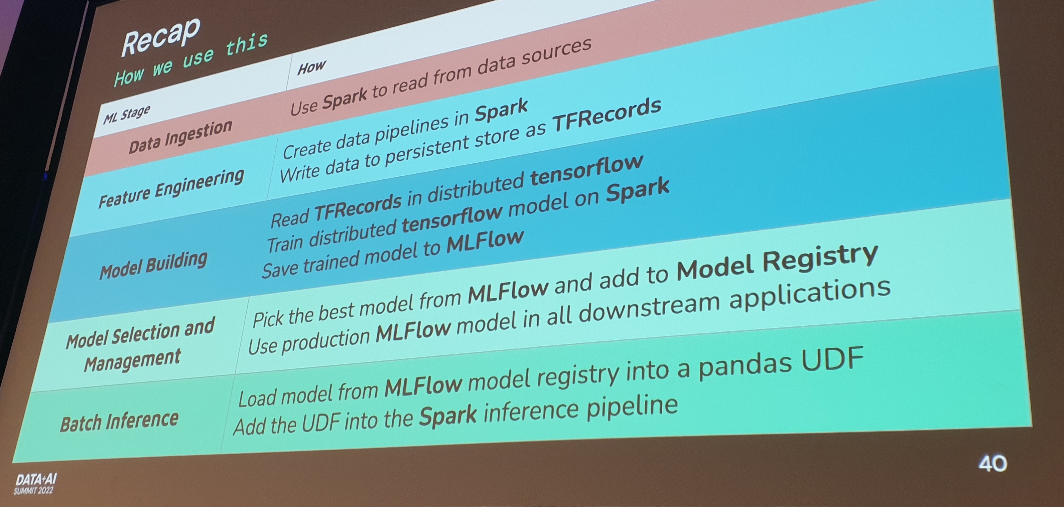
Training Session: Apache Spark + Tensorflow on Databricks

